Slide 1


Elagabalus:
The Genderqueer Ruler of Rome

Slide 2
Notes About This Text
The rainbows you will see in this chapter are links to an appendix which includes additional information. Click on these links to learn more about the topics discussed in the main text.
Teachers, your feedback is crucial to help us understand the impact of the “Queering the Pasts” educational resources. Please take a few minutes to share your thoughts and experiences via this survey.
Please refer to the teachers’ guide attached here for information about teaching this material, additional activities, and other guidance.
If you would like to get in touch with us, please send us an email at qtpcommittee@gmail.com.

Slide 3
Key Questions
How are queer people presented in history?
How are queer people who had power, like Elagabalus, represented once they are out of power?
How can we tell if historical sources are biased?
What can we learn from sources that are biased?
1

Slide 4
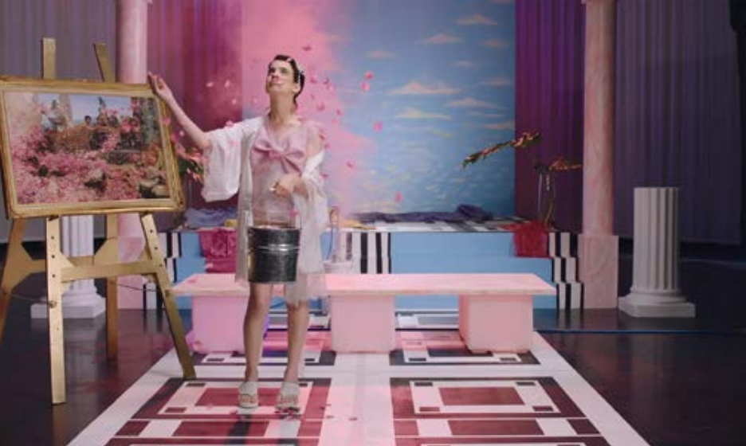

A common misconception is that trans and genderqueer people are a modern or new phenomenon. To the contrary, these identities and experiences are well-documented in the ancient Mediterranean. In fact, one genderqueer person was even the Emperor of Rome!
Sadly, for the young person whose birth name was Varius Avitus Bassianus (ca. 203–222 CE), holding political office didn’t work out very well.
Bassanius became Emperor in 218 CE, and they were named Marcus Aurelius Antoninus at the time. Nowadays we know them better as Elagabalus (or Heliogabalus). Unfortunately, Elagabalus’ rule was not long. After only four years in the job, in 222 CE, they were assassinated — like many other emperors
The screenshot above is from a short film about a genderqueer Elagabalus. Find out more by clicking on the rainbow.
2

Slide 5
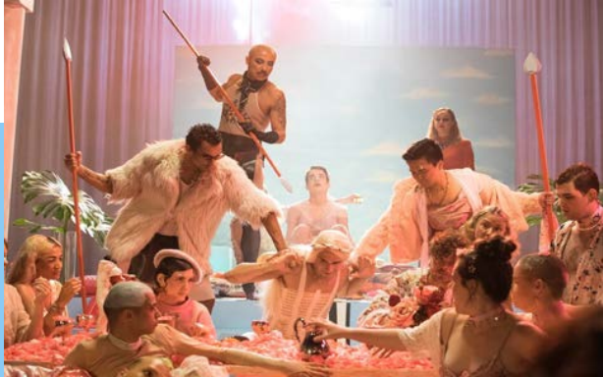
We possess a fair amount of information about Elagabalus’ short life, including the reasons why they were assassinated, but unfortunately our sources may be biased. In Roman histories and even in more modern works, Elagabalus’ gender expression and sexual behaviour have been held up as evidence of their lack of fitness to rule.
For instance, Elagabalus has been reported as being attracted to men, of marrying his charioteer, of dressing like a woman, of wanting to become a woman. At the same time, based on these various characterisations, Elagabalus is often referred to with pride as being genderqueer, with the pronouns ‘they’, ‘she’, or ‘he’, though we will refer to the Emperor using ‘they’
Above is a second screenshot from a short film about a genderqueer Elagabalus. To find out more click on the rainbow.
3

Slide 6

What is genderqueerness, and why use the pronoun ‘they’ with regards to Elagabalus? Genderqueer is a term that indicates someone’s queer or non-normative experiences with gender. One crowd-sourced queer dictionary defines being genderqueer as a ‘catch all term’ that includes trans, nonbinary, and gender-non-conforming people. This definition fits the diverse range of gendered behaviours that Elagabalus performed.
Similarly, the singular pronoun ‘they’ can capture being gender neutral and/or genderqueer. It may surprise you to know that this use of ‘they’ has been standard in English since the late 1300s.
Historians do not all agree what are the most appropriate terms to use for Elagabalus’ gender and sexuality. You might come to a different conclusion based on the evidence we will discuss in this chapter. In modern times, the emperor has been labelled not only genderqueer, but also a trans woman, nonbinary, a man who is attracted to men, and a drag queen.
Their fate as emperor may have been due to their flouting of gender norms. But, it could also be because they tried to completely reinvent Roman religious practices, which might have angered Rome’s priests.
How many of these stories can we believe? How are they connected? And how are they still relevant now?
The genderqueer flag.
4

Slide 7
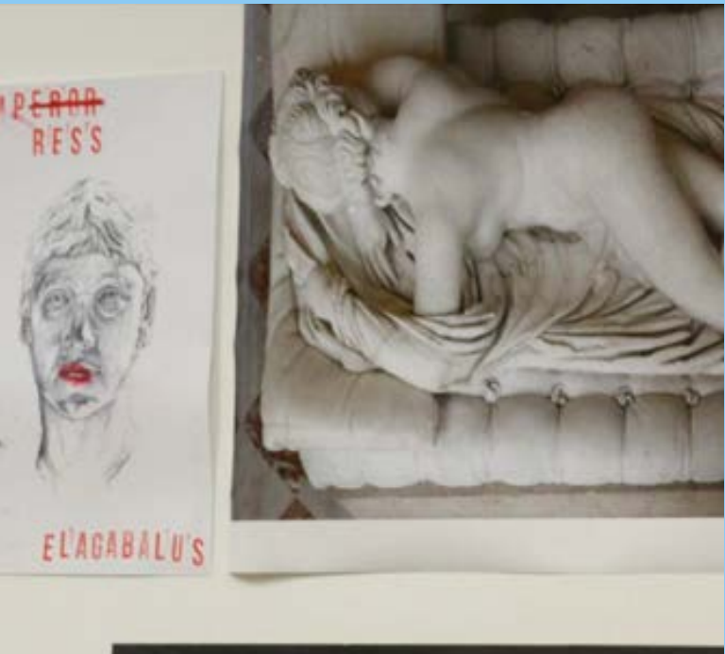
‘Call Me Lady’
Image taken of an artist’s response to Elagabalus at Museum Remix. It is part of a temporary display of new installations created and co-curated by Luis Jimenez, Lizzie Knott, Suzy Rickard, Jack Silvester and Lily Stancliffe. To find out more click the rainbow.
Two ancient historians in particular wrote about Elagabalus: Cassius Dio and Herodian. The stories told by these writers have led the modern trans community to take notice of Elagabalus.
One such story, told by Cassius Dio, involves a handsome chariot driver called Hierocles. Apparently, Elagabalus married Hierocles, taking the role of wife with Hierocles as their husband (Roman History 80.15.1-2). We have to remember that someone like Hierocles couldn’t have said ‘no’ to the Emperor, thus we cannot know if he loved Elagabalus in return.
Another story told by Cassius Dio involves a famously attractive man named Zoticus. Elagabalus demanded to see this beautiful man, and when they met, Zoticus said ‘My Lord Emperor’, but Elagabalus responded ‘Call me not Lord, for I am a Lady (Roman History 80.16.1-4).
5

Slide 8
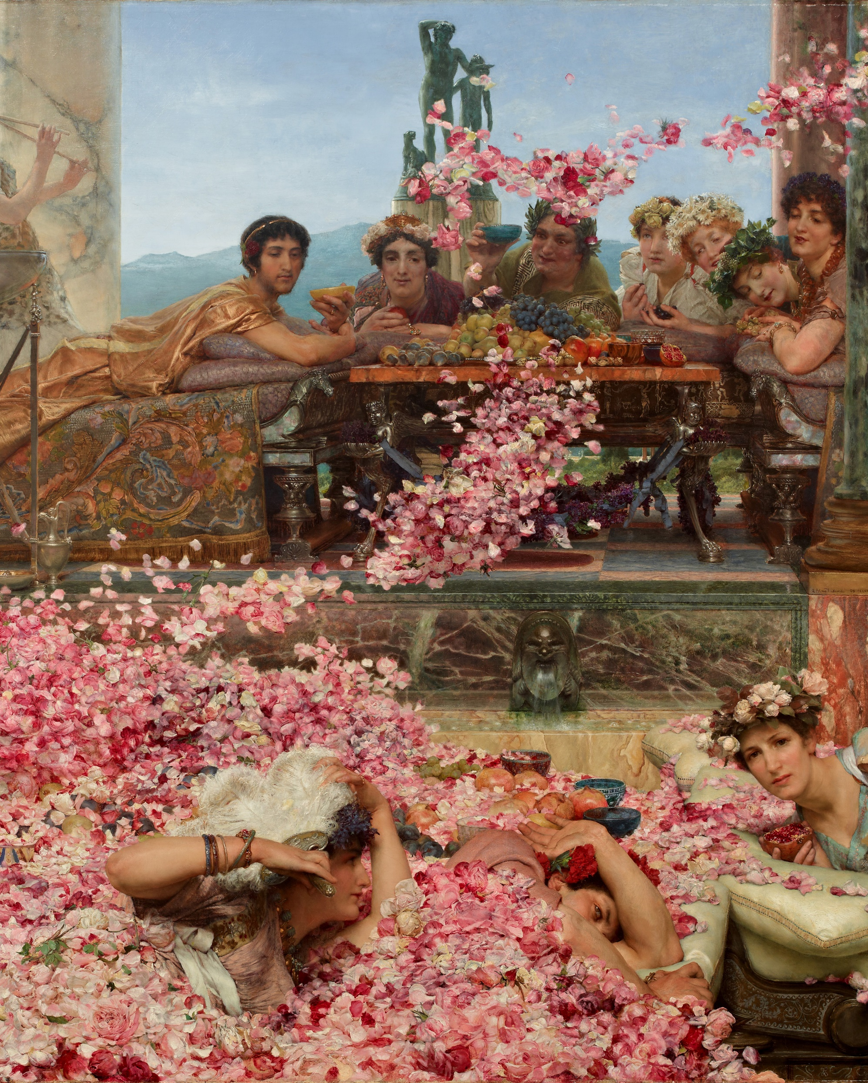
According to Herodian, Elagabalus had the habit of wearing a great deal of make-up and jewellery, so much that it would have been over the top for a woman (Herodian, History of the Roman Empire 5.5).
But Elagabalus was not only feminine. At the same time, they performed masculinity. Broadly put, this is a process of using certain language, modes of speech, gestures, and social cues to signal historically and culturally established ideas about gender to other people. For example, Cassius Dio comments on how the emperor often dressed as a man (in a toga), when appearing in public as the Emperor (Roman History 80.14.3). Depictions of Elagabalus in statue busts and on coins show them with a moustache.
Elagabalus’ most famous statement is recorded by Cassius Dio. He says that Elagabalus ‘asked the physicians to contrive a woman’s vagina in his body by means of an incision, promising them large sums for doing so’ (Cassius Dio, Roman History 80.16.7). Today, we would call a gender-affirming surgery like this one a ‘vaginoplasty’, a medical procedure to construct a vagina.
Sir Lawrence Alma-Tadema (1888) The Roses of Heliogabalus, oil on canvas, private collection. The painting shows Elagabalus relaxing at their extravagant court. While they are having dinner, 6 rose petals are falling from the ceiling and draping the hall in pink
6

Slide 9
But did Elagabalus do and say these things? Some of them, perhaps. Our sources were written for an audience that, for the most part, had been alive during the reign of Elagabalus. If the author had invented too much, their work would have quickly been discredited.
Surely something like the Emperor getting married, even to a charioteer, would have been public knowledge, so it would have been dangerous to invent details like this. Also, the fact that Cassius Dio and Herodian agree in calling Elagabalus ‘womanish’ and ‘soft’, suggests that this might have been common knowledge in Rome.
But we know that neither Cassius Dio nor Herodian would have been direct witnesses to the things they say that Elagabalus said and did. It’s easy to imagine, therefore, how their accounts might include inaccuracies
Another point to consider is how similar these descriptions of Elagabalus are to another historical figure, Sardanapalus, the Last King of Assyria. Historical accounts of Sardanapalus talk about his ‘effeminate’ behaviour supposedly causing the downfall of his empire. The Sardanapalus story was based on real events from the reign of Ashurbanipal, but they have been very poorly remembered. This story reveals that ancient historians were quite happy to invent some major ‘facts’. How might this inform our thoughts about the reliability of sources we have for Elagabalus?
7

Slide 10
Discussion questions:
Review the information given above and write a list of traits that a Roman might have thought of as masculine or manly.
How similar are these to modern ideas about ‘manly’ behaviour?
What can you infer about Roman attitudes towards women and femininity from the information given on pages 5-7?
8

Slide 11
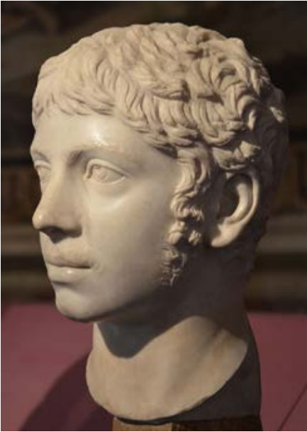
The Religious Controversy
What made people consider Elagabalus a bad Emperor in the first place? Remember that we said earlier that Elagabalus also might have gotten into trouble for their religious practises.
Elagabalus wanted to convert the Romans to the worship of a sun god from Syria, El’Gabal. Elagabalus insisted that El’Gabal was more important than any other god, even Jupiter (the king of the Roman gods). In fact, the nickname Elagabalus comes from the name El’Gabal, and is a sign of their devotion to this god.
Elagabalus had a sacred representation of El’Gabal, a large black stone, brought from Emesa. They built a brand new temple to house it on the Palatine Hill in Rome near the Imperial Palace. New religious rituals and festivals were added to the official calendar, and Elagabalus led them as high priest of their most sacred traditions. Ancient historians made sure to present it that way.
This marble bust portraying Elagabalus can be found at the Capitoline Museums in Rome. It is dated around 221 AD.
9

Slide 12
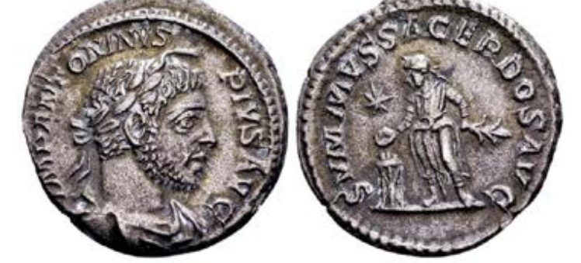
This alone wasn’t a very unusual or terrible idea. It was quite common for Romans to absorb new deities and rituals into their religion. For example, the queen of the Egyptian gods, Isis, and the Greek god Dionysus came to be very popular in Rome.
The scandal came when Elagabalus violated one of the most ancient and sacred parts of Roman religion: they married one of the Vestal Virgins. The temple of Vesta had been a key part of Roman religious life for hundreds of years, and the most significant thing about her priestesses was their vow to remain chaste and unmarried.
Elagabalus may have thought the marriage was symbolic. A union of the great El’Gabal and Rome’s favourite goddess. The Romans probably saw it as a violation of one. So the stories about Elagabalus’ gender and sexuality, which were designed to shock Roman audiences, might have been inspired by this scandalous marriage.
This is a Silver denarius (coin) of Elagabalus, dated around 218-222 CE. On one side, Elagabalus is depicted wearing a laurel crown. The other side of the coin shows them wearing Syrian priestly robes, performing a religious sacrifice.
10

Slide 13
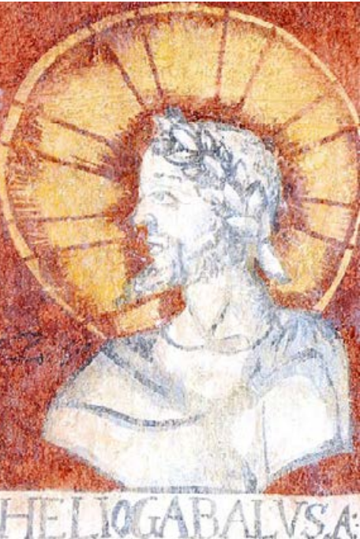
Discussion questions:
As we mentioned earlier, the ancient Romans often added new gods to their religion upon coming in contact with other cultures. For example, the queen of the Egyptian gods, Isis, was a popular deity in Rome.
Similarly, when the Romans conquered other people, they sometimes fused one of the Roman gods with a local god so the Romans and the conquered people could worship together. A good example of this is Minerva Sulis, a combination of the Roman goddess of wisdom with a British goddess who was worshipped near the modern town of Bath.
Do some research online – can you find any other examples of this happening?
What aspect of Elagabalus’ religious policy do you think caused the most upset in Rome?
Wall painting of Elagabalus 18th century CE, Forchtenstein Castle, Austria. (Heliogabalus was another name by which Elagabalus was known). The painting shows a bust of Elagabulus, depicted in white against a red background, with their head surrounded by a golden circle. Under it, the letters HELIOGABALVSA identify the portrait.
11

Slide 14

Elagabalus since Antiquity
Elagabalus’ fame as a bad emperor usually overshadows their role as a queer historical figure. In his famous political treatise, The Prince, Niccolò Machiavelli lists Elagabalus as an example of a bad emperor who did not last ling, but he doesn’t explain why.
Popular interest in Roman decadence seems to start, at least in English, after the publication of Edward Gibbon’s mammoth work, the History of the Decline and Fall of the Roman Empire (1776-1789), excerpted in the activity later.
Gibbon, as his title suggests, was interested in what went wrong for the Romans. With Britain in the process of establishing an empire of its on, he was keen to draw lessons from history. While accepting that Cassius Dio and Herodian might not have been unbiased, Gibbon states of the deeds of Elagabalus, ‘their inexpressible infamy surpasses of any other age or country’. The enormous success of Gibbon’s work set the reputation of Elagabalus for 200 years to come.
In Anselm Kiefer’s Antonin Artaud’s Heliogabalus (2010-2011), the artist responds to Elagabalus’ deification and their role as Emperor. The painting, mostly using grey colours, showcases two wings on an empty background.
12

Slide 15
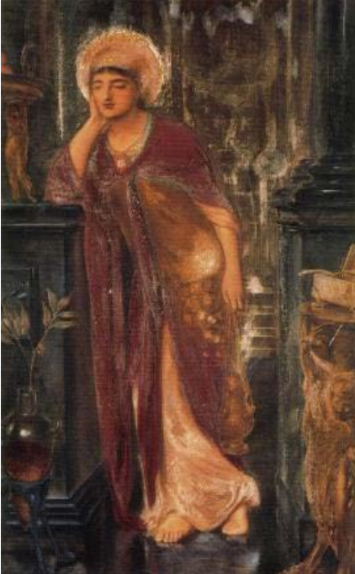
It didn’t help that Gibbon’s work shot to fame just before the start of the 19th century, when any deviance from social norms with respect to gender and sexuality was swiftly condemned.
Elagabalus, then, became a symbol of all that was bad about Rome. Their alleged depravity was so well known that composers Gilbert and Sullivan, in the popular comic opera The Pirates of Penzance, were able to mention Elagabalus’ ‘crimes’ and expect their audience to know what they were talking about.
Still, not everyone has seen Elagabalus as wicked. The great (queer) pre-Raphaelite painter, Simeon Solomon, produced a beautiful portrait of Elagabalus as high priest of the sun (see his painting of Sappho in Chapter 1).
Many contemporary queer folk are now taking notice of Elagabalus, and starting to write their own works (NB: this poem contains the use of a swear word, please view with discretion). In Canada the writer and drag performer, Sky Gilbert, has written a play titled, Heliogabalus: A Love Story and many more have taken to the internet to explore Elagabalus’ story for themselves.
Heliogabalus, High Priest of the Sun Simeon Solomon, 1866, pencil and watercolour. The painting shows Elagabalus propped up on a table, wearing a red robe and religious insignia.
13

Slide 16
Activities:
Summarise how Elagabalus was presented by ancient sources in one sentence.
All of the information we have about Elagabalus was produced after their assassination. How do you think this has impacted what we “know” about Elagabalus today?
If you could ask Elagabalus three questions to learn more about their life, what would they be?
14

Slide 17
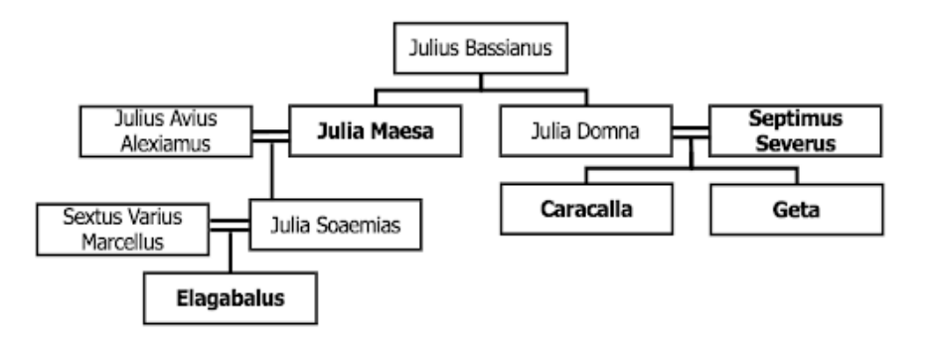
A Knotty Family Tree
Elagabalus was born to Syrian parents in Rome. Their grandmother, Julia Maesa, was the sister-in-law of the Emperor of the time, Septimius Severus. Julia Maesa was also a descendant of the royal family that had ruled the Syrian city of Emesa before it became a part of the Roman Empire over a century earlier
Her nephews, Caracalla and Geta, both succeeded their father as Emperor. Carcalla and Geta had been left in joint charge of the Empire. But Geta was soon murdered, supposedly on the orders of his brother, or even by Caracalla himself.
When Caracalla died, a faction of the Roman army elected a man called Macrinus to be Emperor. He was unpopular with the senate and with those soldiers who remained loyal to the memory of Caracalla and the Severan family – so Julia Maesa came up with a plan
15

Slide 18
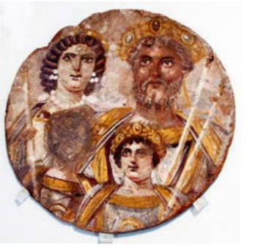
She spread the rumour that young Elagabalus was secretly the son of Caracalla, and thus his rightful heir. The loyal factions of the army found this to be a convenient story and, after a battle near Antioch, Elagabalus became Emperor.
Julia Maesa and her family were from Syria. Late in his life, Septimius Severus moved his entire court to York as a base of operations for the conquest of lands north of Hadrian’s Wall. The young Elagabalus probably spent three cold years there with him.
For more background on Elagabalus and the Severan dynasty, check out this further reading guide (click on the rainbow below). You can also listen to this podcast, ‘Severan Sisters at War: The Rise and Fall of Elagabalus’, featuring Matilda Brown, a researcher at the University of Edinburgh.
This painting named “Damnatio Memoriae” or Berlin Tondo is from around 200 CE. It depicts members of the Severan dynasty. Julia Domna and Septimius Severus (who ruled from 193-211) are in the back.
16

Slide 19
How Do We Know? A Closer Look at Cassius Dio and Herodian
Our main sources about Elagabalus are historians Cassius Dio and Herodian. In ancient Rome, education was only guaranteed to the elite: authors would have had to be fairly wealthy in order to be able to spend time writing. And they were generally fairly conservative in their attitudes. Think of them as the sort of people who support the current ruling party and are paid to write judgmental opinion columns about other people.
Importantly, neither had firsthand knowledge of or acquaintance with Elagabalus while they were emperor. It is possible that Cassius Dio would have come into at least peripheral contact with the young Elagabalus, since he was serving as the Governor of the city of Smyrna in Western Turkey at the time. Herodian, on the other hand, was not important enough to have had much access to the Imperial Palace. Cassius Dio was born in the country of Bithynia on the north coast of modern-day Turkey; his father had been a Senator. He too became a Senator, and eventually even a Consul, the highest political office below the Emperor. He held important posts under the Emperors Commodus, Septimius Severus, and most importantly Severus Alexander.
Severus Alexander was Elagabalus’ younger cousin, who took the throne after Elagabalus was murdered. The young Alexander made Cassius Dio Consul for a second term. So when we read what Cassius Dio has to say about Elagabalus, we should perhaps imagine Alexander looking over his shoulder and muttering, ‘yes, great insult, Rome is much better off with me in charge!’
Herodian did not occupy such an important position, and we therefore know less about him. He was apparently a civil servant who was living in Rome when Elagabalus was Emperor. We don’t know where he was born, but it seems from his writing that it was somewhere in Egypt or the Middle East as he spends a lot of time explaining Roman customs to his audience.
Given his outsider status, he is perhaps more likely to have been sympathetic to Elagabalus. Although he finished writing his book at least sixteen years after Elagabalus’ death, the story he tells of Elagabalus includes some of the same insults and rumours we see in Dio’s work. True or not, they were probably viewed as common knowledge at the time!
17
Click here for a glossary of terms

Slide 20
Source analysis activity 1
Written ancient sources can be challenging for modern historians to use for several reasons. First, their writers often include outright lies or half-truths in their work. And of course they leave out what they don’t know, but they can also choose to leave out other important details that don’t suit their purpose.
These are all ways that bias can impact the evidence. Modern historians try to understand whether sources are likely to contain bias so they can be wary of just believing everything they read. One important way of telling whether sources are likely to contain bias is to understand who the author was, as well as what their reasons for writing may have been. Review the information above and make notes in a table like this:
Things that make Cassius Dio seem knowledgeable and trustworthy: | Things that make Cassius Dio seem like he might not have known very much or reasons why he might have lied: | Things that make Herodian seem knowledgeable and trustworthy: | Things that make Herodian seem like he might not have known very much or reasons why he might have lied:
E.g. Dio felt he had some knowledge of the kind of person that Elagabalus was, given his occasional involvement with the imperial family
18

Slide 21
Source analysis activity 2
We are now going to look at two sources on Elagabalus: the first was published in the early 3rd century CE, and the second is from the late 18th century CE. Both of these sources talk about the Emperor in very negative terms. Why might they be doing this?
As you read:
Highlight any phrases that seem to relate to gender or to gender roles.
Underline key words or sentences that characterise Elagabalus negatively.
19

Slide 22
Source 1: Cassius Dio, Roman History 80.13-16
Note: Cassius Dio uses he/him/his pronouns for Elegabalus; we use they/them/their pronouns.
But this Sardanapalus [= Elagabalus], who saw fit to make even the gods cohabit under due form of marriage, lived most licentiously himself from first to last. He married many women, and had intercourse with even more without any legal sanction [...] He used his body both for doing and allowing many strange things, which no one could endure to tell or hear of [...] He would go to the taverns by night, wearing a wig, and there ply the trade of a female peddler. He frequented the notorious brothels, drove out the prostitutes, and played the prostitute himself. [...] When trying someone in court he really had more or less the appearance of a man, but everywhere else he showed affectations in his actions and in the quality of his voice. [...] He was bestowed in marriage and was termed wife, mistress, and queen. He worked with wool, sometimes wore a hair-net, and painted his eyes, daubing them with white lead and alkanet. Once, indeed, he shaved his chin and held a festival to mark the event; but after that he had the hairs plucked out, so as to look more like a woman. [...] He wished to have the reputation of committing adultery, so that in this respect, too, he might imitate the most lewd women [...] This was one of the things that was destined to lead to his destruction.
Adapted from: https://penelope.uchicago.edu/Thayer/e/roman/texts/cassius_dio/80*.html
20

Slide 23
Source 2: Gibbon, The History of the Decline and Fall of the Roman Empire, chapter 6
Note: Gibbon uses he/him/his pronouns for Elegabalus; we use they/them/their pronouns.
Elagabalus, (I speak of the emperor of that name,) corrupted by his youth, his country, and his fortune, abandoned himself to the grossest pleasures with ungoverned fury [...] The master of the Roman world affected to copy the dress and manners of the female sex, preferred the distaff to the sceptre, and dishonoured the principal dignities of the empire by distributing them among his numerous lovers; oqne of whom was publicly invested with the title and authority of the emperor’s, or, as he more properly styled himself, of the empress’s husband. [...] It may seem probable, the vices and follies of Elagabalus have been adorned by fancy, and blackened by prejudice. Yet [...] their inexpressible infamy surpasses that of any other age or country. The licence of an eastern monarch is secluded from the eye of curiosity by the inaccessible walls of his seraglio (=palace). [...] [Elagabalus], viewing every rank of his subjects with the same contemptuous indifference, asserted without control his sovereign privilege of lust and luxury.
Adapted from: https://www.ccel.org/g/gibbon/decline/volume1/chap6.htm
21

Slide 24
Source comprehension and analysis questions
List three things that these two sources agree on.
What would you like to know about Gibbon to decide whether his account is likely to contain bias?
Can you make any guesses about whether Gibbon’s account contains bias, based only on what he has written? Consider Gibbon’s description of not only Elagabalus’ gender but also their ‘Eastern’ heritage.
Both of these sources are talking about a person who was Emperor of Rome. What kinds of information do you think they would have included if they had a positive opinion of Elagabalus?
“When you find two sources that say the same thing, they back one another up and so are very likely to be true.” Do you agree with this statement? Why or why not?
Can you think of any other examples (from throughout history or in our world today) where people have written in very negative terms about people from minority or marginalised groups?
Why is it so important for us to be wary of bias when we read history or news?
22

Slide 25
Glossary of Roman political offices
Senate: The Roman Senate was an assembly within the Roman government. During the imperial period, however, the Emperor had absolute power over the Senate.
Senator: A member of the Roman Senate. All Senators belonged to the patrician class — that is, they were wealthy landowners — and they wore a purple stripe on their toga to represent their status.
Consul: There were two Consuls, elected every year, who occupied the highest political office below the Emperor. Think of them as the Emperor’s right hand advisors. They were more powerful in the time of the Roman Republic, but in the imperial period served a more symbolic function.
23

Slide 26
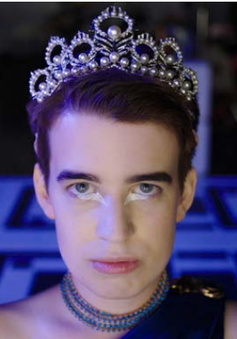
‘Trans-’ etymology
The word ‘trans’ and prefix ‘trans-’ come from the Latin preposition trans, meaning ‘across, on the far side, beyond’. In English, this is where we get the ‘trans-’ in ‘transgender’.
You can also add the prefix ‘trans-’ to verbs, which is how the word ‘transition’ was originally formed: it comes from the Latin verb transire (trans- + ire, ‘to go’), which means ‘to go across’.
The word ‘cis’ and prefix ‘cis-’ operate similarly, as in ‘cisgender’, and come from the Latin cis, meaning ‘on the same side’. Both these words have been commonly used by scientists for centuries, to describe how molecules bond and genes are expressed.
Most words that start with ‘trans-’ suggest movement from one space to another. For example, transport or transplant. This can work in a similar way with some transgender experiences, where a person can ‘move’ from one gender to another.
Because of this, scholars in trans studies have long celebrated the open-endedness and versatility of the prefix ‘trans-’, which can also be tied to several other words, such as transnational, transgenerational, and transspecies. Can you think of other examples? What does ‘trans’ mean to you?
A 2020 short film about a genderqueer Elagabalus.
24

Slide 27
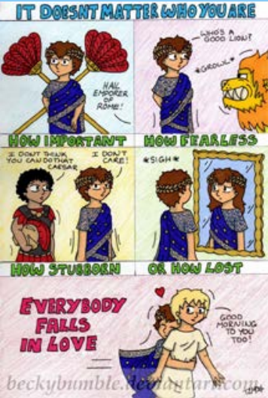
Elagabalus and Internet Culture
Elagabalus and Hierocles' relationship has inspired many content creators to explore more about Elagabalus on sites such as Tumblr, DeviantArt, and Archive of Our Own.
According to Cassius Dio (Roman History 80.15.1-2), Hierocles was a Carian slave who happened to catch Elagabalus’ attention when he fell in front of them during a chariot race. Struck by his beauty, Elagabalus immediately invited him to the palace.
While Cassius Dio notes that Elagabalus seemingly had other lovers, he also states that their ‘affection for this ‘husband’ was no light inclination, but an ardent and firmly fixed passion’. Elagabalus granted Hierocles his freedom and even wanted to make him Emperor: for his part, Hierocles stayed with them until his death in 222, when he was executed after Elagabalus’ fall from power.
There is not much information on Elagabalus’ and Hierocles’ relationship, but the internet has made its own, thanks to fanfiction and fanart, inventing and exploring the way they would have acted, talked to each other, expressed their feelings.
Fanfiction allows writers and readers ‘to ask and answer speculative and reflective questions about our own lives, in a way that might get others to pay attention’ (Burt 2017), relating to historical or fictional characters. Elagabalus’ own story and their relationship with Hierocles have inspired many young LGTBQ+ artists and writers, who may find in Elagabalus someone they can relate to.
Sites like Deviant Art are awash with queer artistic responses to Elagabalus, for example the comic strip above by BeckyBumble.
25

Slide 28
Elagabalus’ own story and their relationship with Hierocles have then inspired many young LGTBQ+ artists and writers, who may find in Elagabalus someone they can relate to.
Activity:
Fanfiction is defined as something operating on works whose copyright is held by others, but ancient history does not have its own copyright. Who, then, if anyone, does the story of Elagabalus belong to?
26

Slide 29
Further resources and bibliography
Burt, Stephanie (2017). “The Promise and Potential of Fan Fiction” The New Yorker (August 23).
Transgender Lives in Ancient Rome: The Case of Empress Elagabalus (Spectrum South)
A Brief Biography of Elagabalus: the transgender ruler of Rome (OutHistory)
Roman Historians: Unreliable Narrators? Part 1, Part 2 by Cheryl Morgan (Write Where it Hurts)
Elagabalus, the Empress (Making Queer History)
Elagabalus, The Trans Emperor of Rome? (History @ Birmingham)
Episode 21: The Real Housewife of Rome (History is Gay Podcast)
Rantala, Julia (2020). “Ruling in Purple...and Wearing Make-up: Gendered Adventures of Emperor Elagabalus as seen by Cassius Dio and Herodian” in Allison Surtees and Jennifer Dyer, eds., Exploring Gender Diversity in the Ancient World. (Edinburgh: Edinburgh University Press): pp. 118-28.
27

Slide 30
Image Index
The Roses of Heliogabalus by Alma-Tadema (1888), oil on canvas. Private collection.
Silver coin depicting Elagabalus as Sol Invictus, ‘unconquered sun god’ (218-222 CE). RIC IV/2, Elagabalus, n° 88, p. 34; BMCRE V/2, Elagabalus, n° 12, p. 562.
Wall painting in the inner courtyard of Castle Forchtenstein (Austria) showing Heliogabalus, also known as Elagabalus (18th century). Castle Forchtenstein.
Antonin Artaud’s Heliogabalus by Anselm Keifer, (2010-2011), oil on canvas. White Cube London. Photographed by Ben Westoby.
Heliogabalus, High Priest of the Sun by Simeon Solomon (1866), pencil and watercolour. Dudley Gallery.
Severan tondo, or portrait of the family of Septimius Severus (ca. 2nd century CE). Altes Museum Berlin.Inv.-No.: 31329 Photographed in 2017 by José Luiz Bernardes Ribeiro.
Elagabalus - Everybody Falls in Love by BeckyBuble. Deviantart. <https://www.deviantart.com/beckybumble/art/ElagabalusEverybody-falls-in-love-284902850>.
Marble bust of Roman emperor Elagabalus, ca. 221 AD, Capitoline Museums.
28

